Slide 1
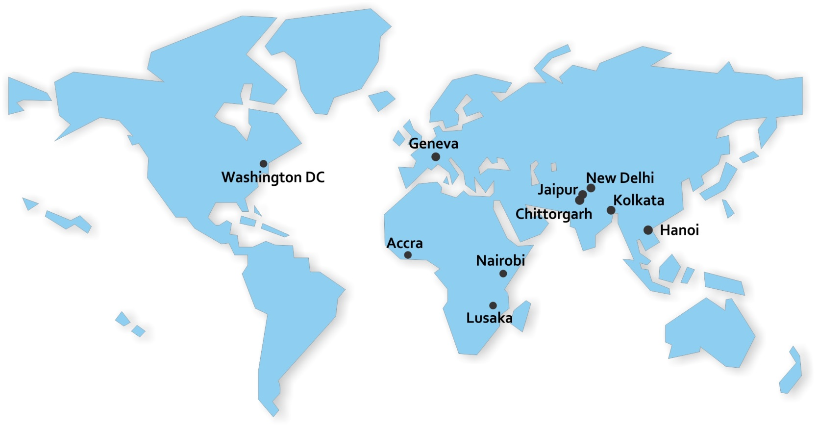
Value for People
Consumer Unity & Trust Society
www.cuts-international.org

Slide 2
Vision & Mission
Vision
Consumer sovereignty
Mission
Consumer sovereignty in the framework of social justice, economic equality and environmental balance, within and across borders

Slide 3
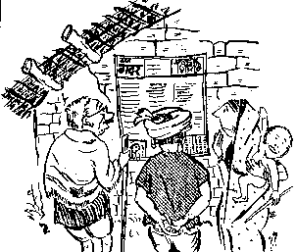
A Brief History
In 1983, CUTS began its journey with a rural development communication initiative – a wall newspaper Gram Gadar (Village Revolution)
Evolved from work on consumer protection to an internationally reputed policy action- and think-tank on inter-related areas of Governance, Trade and Regulation
A non-profit, non-governmental organisation with its headquarters in Jaipur, India, resource centres in Kolkata, Chittorgarh and New Delhi in India and six overseas centres: Geneva (Switzerland), Hanoi (Vietnam), Nairobi (Kenya), Lusaka (Zambia), Accra (Ghana) and Washington DC (USA)

Slide 4



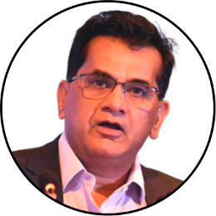
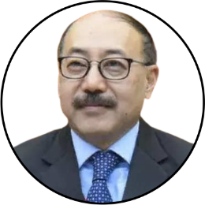
CUTS@40
Celebrating the 40th Anniversary of CUTS is truly a momentous occasion, particularly for a civil society organisation hailing from a developing country. I wholeheartedly extend my congratulations to Pradeep S Mehta and the entire CUTS team for their remarkable dedication and impactful endeavours. Pradeep's constructive criticisms have played a vital role in shaping their work. I would like to pay tribute to him and express my deep admiration for the organisation's invaluable contributions.
Ngozi Okonjo-Iweala
Director-General of the WTO
I would like to extend my heartfelt appreciation to Pradeep Mehta and the entire team at CUTS for achieving this significant milestone. CUTS embodies the spirit of a bootstrapped start-up, having grown and expanded without extensive support from external sources. Pradeep's unwavering determination to pursue groundbreaking work, especially in the realm of trade, is truly commendable. It was during a time marked by rampant protectionism that hindered both economic growth and our capacity to uplift those living in poverty.
Amitabh Kant
G20 Sherpa
I am delighted that CUTS International has shown keen interest in the G20 and is making substantial contributions through various channels, notably as part of the Think20 (T20) Initiative. I was involved in several initiatives led by CUTS, including a remarkable compilation of targeted export promotion endeavours. It comes as no surprise that CUTS today is one of the most prominent think tanks in our country with a global outreach.
Harsh Vardhan Shringla
India’s G20 Chief Coordinator

Slide 5
Attributes & Values
1
3
2
4
Adopting a centrist/
bottom up approach through research and advocacy
Ensuring outcomes, rather than just outputs
Focus on areas (subject and geographical areas) where a vacuum
and need exists
Carved a niche for itself in research, advocacy and networking on several issues of public interest (modelled on an evidence-based policy advocacy and capacity building approach)

Slide 6

Focus Areas
Programme Areas
Topics (Current and Future)
Rules-based Trade
WTO Issues
Developmental Issues including sustainability
Regional Economic Cooperation
Effective Regulation
Competition Policy and Law
Economic Regulation
Investment Climate and Private Sector Development
Digital Economy
Good Governance
Consumer Protection
People’s Participation
Accountability
Access to Information

Slide 7

Indian Centres
Centre for Consumer Action, Research & Training, Jaipur
To enable people, particularly the poor and the marginalised, to achieve their rights to basic needs and sustainable development, through a strong consumer movement
www.cuts-cart.org
Centre for Human Development, Chittorgarh
To be an innovative centre for strategic interventions to raise the living standards of people
www.cuts-chd.org
Centre for International Trade, Economics & Environment, Jaipur
Pursuing economic equity and social justice within and across borders by persuading governments and empowering people
www.cuts-citee.org

Slide 8
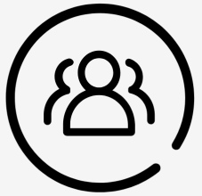

Indian Centres
Centre for Competition, Investment & Economic Regulation, Jaipur
Promoting fair markets to enhance consumer welfare and economic development
www.cuts-ccier.org
Calcutta Resource Centre, Kolkata
Promote economic equity and sustainable development within and across borders in Eastern South Asia through evidence-based advocacy and consumer empowerment
www.cuts-crc.org
Delhi Resource Centre
To feed the work being done at the national level by other Centres of CUTS
www.cuts-drc.org

Slide 9


Indian Centres
CUTS Institute for Regulation & Competition, Delhi
To officer research, educational and training programmes on competition policy and law and sector regulatory laws
www.cuts-circ.in
CUTS International Public Policy Centre, Jaipur
To cater to the need of state’s national and international affairs of non-political class
www.cippolc.in

Slide 10
Overseas Centres
Promoting South-South Cooperation
Sub-Saharan Africa (Lusaka, Nairobi & Accra)
To promote South-South cooperation on trade and development and strengthen long-term capacity of civil society representatives to address equity and accountability issues
www.cuts-lusaka.org
www.cuts-nairobi.org
www.cuts-accra.org
South East Asia (Hanoi)
To be a catalyst in transferring objective knowledge and advocacy skills from India towards mainstreaming the civil society movement into the development process in the region
www.cuts-hrc.org

Slide 11
Overseas Centres
Credible Southern NGO Voice (Geneva)
To establish and promote a pro-trade pro-equity credible Southern NGO voice in the policy making circles working on trade and development in Geneva
www.cuts-geneva.org
US-India Economic Relations (Washington DC)
To address bilateral and multilateral trade and economic matters of strategic importance to India and the US in the broader Indo-Pacific context
www.cuts-wdc.org

Slide 12

Outreach
Have created sustainable networks from villages in India
to the state, national, regional and international levels
Each centre has e-discussion groups covering issues related to trade, regulation and governance
Publishing a wide spectrum of material for information dissemination for semi-literates to professionals in a reader-friendly format ranging from a wall newspaper to research reports
Extremely adept at organising campaigns, meetings
and seminars from the village level comprising
five-six participants to the National/ International level with over
350 participants

Slide 13

Resources
Affiliated to important national, state committees and a number of international organisations
International Advisory Boards comprising members from diverse backgrounds
Excellent knowledge base and good leadership
Approximately 20,000 sq. ft. of office space with necessary equipment for efficient functioning and timely delivery
Exposure for staff by organising national and international trips

Slide 14
Resources
In-house editorial and desktop publishing
About 120 staff with great diversity, experience and dedication
A well-maintained library-cum-documentation centre with more than 6,000 books and subscription of about 50 journals and e-newsletters in a month

Slide 15

Achievements
Rules-based Trade
CUTS effort to promote agro-processing industry in East Africa as an effective weapon against climate change’s impact on agriculture leading to poverty reduction was captured in Kenya’s new Trade Policy as a policy measure.
CUTS study on ‘Cost of Economic Non-Cooperation to Consumers in South Asia’ resulted in a shift in Pakistan’s trade policy in 2013 to use a ‘negative list’ approach while trading with India. This has contributed in normalising India-Pakistan trade relations and increasing bilateral trade.
The prospects of allowing mechanised boats (20-50 tonne capacity) to navigate across border between Dhubri (India) and Chilmari (Bangladesh) by identifying the potential cargo as well as the socio economic benefits of cross border trade were highlighted by CUTS, and its recommendations were discussed in the 19th Standing Committee on Protocol, following which both were declared as ‘Ports of Call’ in the respective countries.

Slide 16

Achievements
Effective Regulation
CUTS filed a case against a matchbox manufacturer in the year 1985 for perennial shortage of matchsticks in their matchboxes. It discovered that a 50-stick matchbox contains only 35-40 sticks, regardless of the type of the manufacturer. Besides, the quality of matchsticks was extremely poor. The case got a huge publicity, and helped CUTS establish itself.
CUTS made several suggestions which were accepted by the RBI in the Operating Guidelines issued in October 2016, and endorsed by NITI Aayog’s Watal Committee in its Report on Promotion of Digital Payments published in December 2016.
CUTS Accra is acting as a reference point for state and non-state actors on Competition Policy and Law and Consumer Protection issues in Ghana.
CUTS’ recommendations to revise the criteria for rural electrification and bringing down the cost of new connections were incorporated by West Bengal State Electricity Distribution Company Limited.

Slide 17

Achievements
Good Governance
Mother Teresa participated in a panel discussion: ‘Dole vs. Opportunities’ on the occasion of the World Poverty Day, November 01, 1992. This Day was adopted by CUTS in 1990 and endorsed by the consumer movement in India in 1991. Since then, in 1992 the United Nations has adopted the International day for Eradication of Poverty on October 17.
Received appreciation by District Election Commission, Chittorgarh for effective interventions in the area of electoral registration ⎼ meaningful and high voter turnout with greater participation from persons with disability under Systematic Voters' Education and Electoral Participation (SVEEP) Programme launched by the Election Commission of India.
CUTS study on road safety in 1990 became the basis for the National Road Safety Policy adopted by the Government of India in 1993. It was nominated to the National Road Safety Council twice, and to its first high-level Ministerial Committee, which was established to formulate the National Road Safety Policy.

Slide 18

Thank You
About CUTS
CUTS@Grassroots
Non-State Actor Engagement in Policy Making to Mainstream Governance, Trade, and Regulation for Development
MAKING POLICY WORK FOR THE PEOPLE Has CUTS been successful?
30 Years of Social Change
Stories of Change: Glimpses of a Journey: 1983-2018
CUTS@50: A Vision Document
www.cuts-international.org

